Slide 1

More Than Mannerisms
Cross Cultural awareness for short-term teams

Slide 2
More Than Mannerisms
Cross Cultural awareness for short-term teams
Culture is more than a handshake!

Slide 3
MORE THAN MANNNERISMS Cross Cultural awareness for short-term teams
I. You are strange...

Slide 4
MORE THAN MANNNERISMS Cross Cultural awareness for short-term teams
I. You are strange...
A. As Americans (Physical)
1. You have never known hunger
2. 98th-percentile
3. Greatest economy/military might

Slide 5
MORE THAN MANNNERISMS Cross Cultural awareness for short-term teams
I. You are strange...
A. As Americans (Physical)
1. You have never known hunger
2. 98th-percentile
3. Greatest economy/military might
B. As Christians (Spiritual)
1. Most of the world is at enmity with you
2. There are very real powers that desire to stop you from going to the nations

Slide 6
MORE THAN MANNNERISMS Cross Cultural awareness for short-term teams
I. You are strange...
C. Most Americans are task oriented rather than relationship oriented.
1. Consider Hugo...

Slide 7
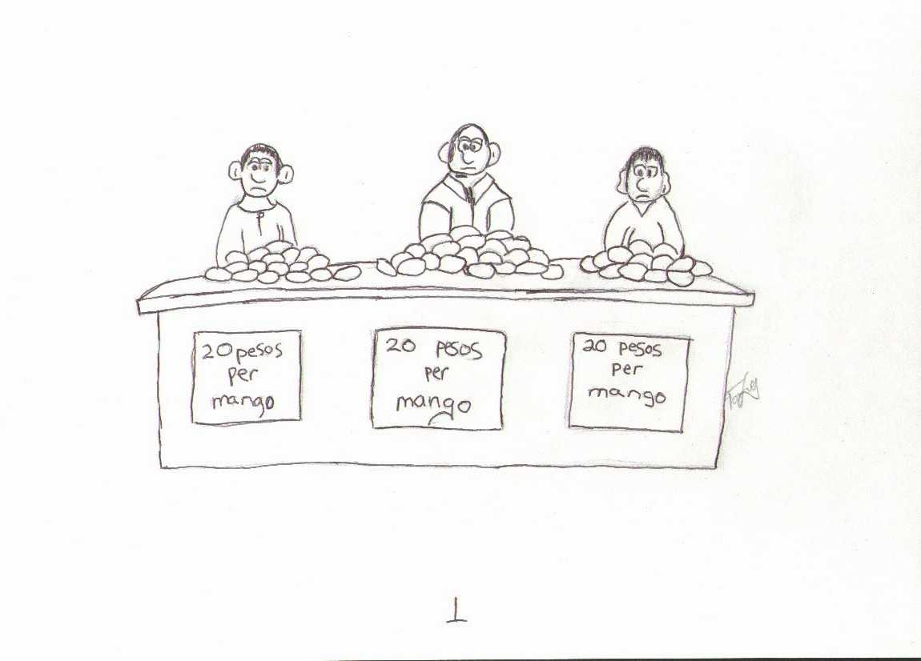

Slide 8
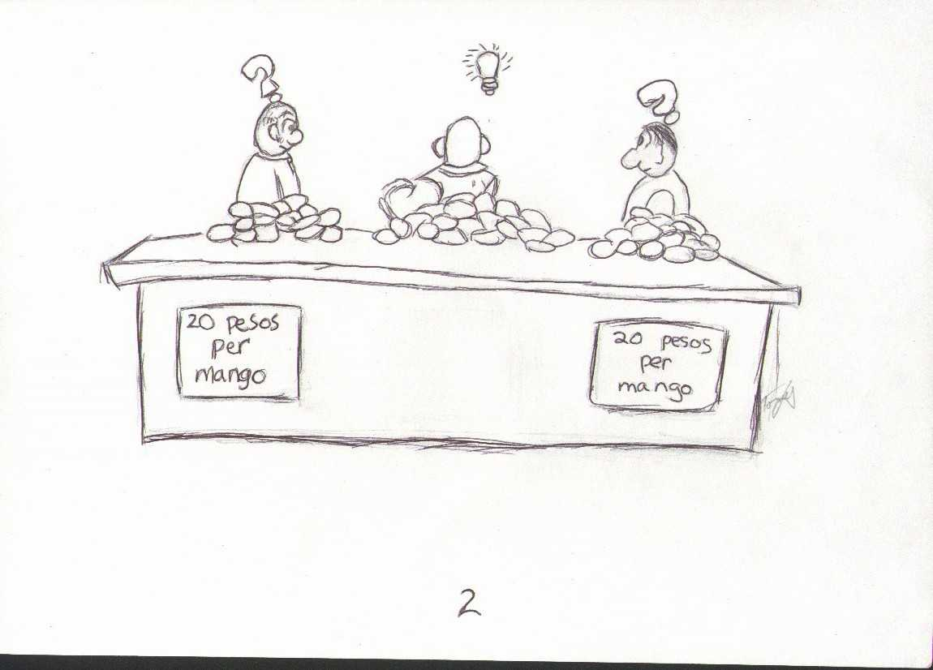

Slide 9
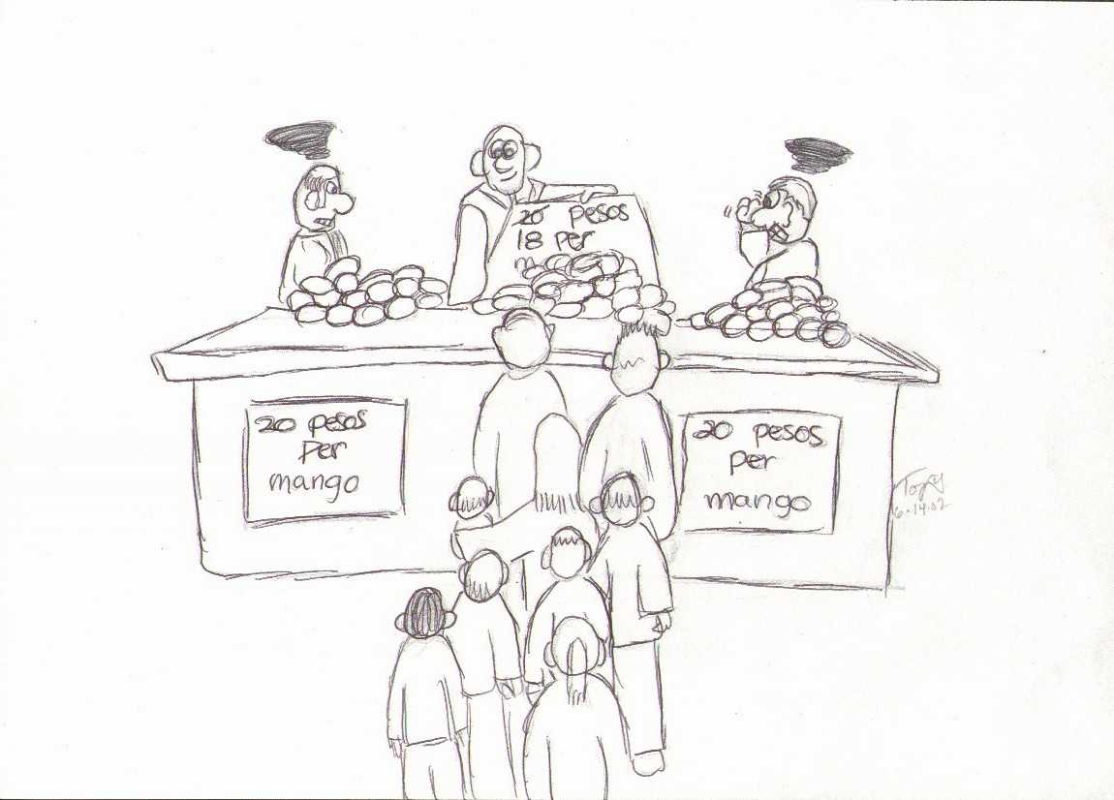

Slide 10
MORE THAN MANNNERISMS Cross Cultural awareness for short-term teams
I. You are strange...
C. Most Americans are task oriented rather than relationship oriented.
1. Consider Hugo...
2. Consider some of our other strange American things...

Slide 11
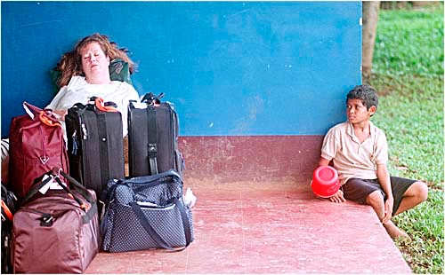
MORE THAN MANNNERISMS Cross Cultural awareness for short-term teams
I. You are strange...

Slide 12

MORE THAN MANNNERISMS Cross Cultural awareness for short-term teams
I. You are strange...

Slide 13
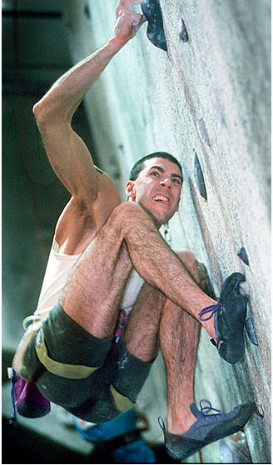
MORE THAN MANNNERISMS Cross Cultural awareness for short-term teams
I. You are strange...

Slide 14
MORE THAN MANNNERISMS Cross Cultural awareness for short-term teams
II. Culture Defined (For Ministry)

Slide 15
MORE THAN MANNNERISMS Cross Cultural awareness for short-term teams
II. Culture Defined (For Ministry)
So, what is culture?
A. The word we use to summarize values, habits, traits, priorities, and thought patterns of a specific group of people. Normative patterns of behavior by the consensus of society.

Slide 16
MORE THAN MANNNERISMS Cross Cultural awareness for short-term teams
II. Culture Defined (For Ministry)
So, what is culture?
A. The word we use to summarize values, habits, traits, priorities, and thought patterns of a specific group of people. Normative patterns of behavior by the consensus of society.
B. The complex, inter-related sets of symbols, values, beliefs, and behavior patterns of a group of people. The total way of life of particular groups of people.

Slide 17
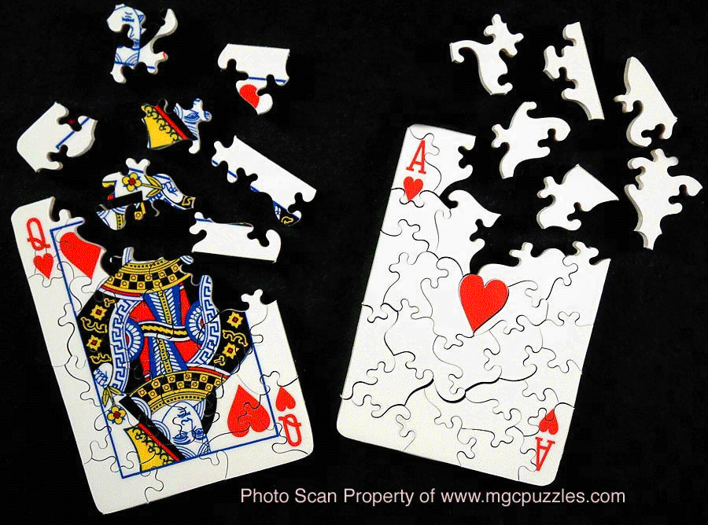
MORE THAN MANNNERISMS Cross Cultural awareness for short-term teams
II. Culture Defined (For Ministry)
For those of that culture all the pieces fit together...

Slide 18
MORE THAN MANNNERISMS Cross Cultural awareness for short-term teams
III. Basic Functions of Culture...
Keeps society ordered...
Keeps conflicts at a minimum and provides methods for dealing with conflicts when they arise
Provides commonality so that new or different areas can be assessed and confronted with its standards

Slide 19
MORE THAN MANNNERISMS Cross Cultural awareness for short-term teams
III. Basic Functions of Culture...
1960’s

Slide 20
MORE THAN MANNNERISMS Cross Cultural awareness for short-term teams
IV. Reality of Culture...

Slide 21
MORE THAN MANNNERISMS Cross Cultural awareness for short-term teams
IV. Reality of Culture...
A. Culture is IMPLICIT & you have it!
1. Elevator Etiquette
2. Urinal Etiquette

Slide 22
MORE THAN MANNNERISMS Cross Cultural awareness for short-term teams
IV. Reality of Culture...
A. Culture is IMPLICIT & you have it!
1. Elevator Etiquette
2. Urinal Etiquette
B. Culture needs to become EXPLICIT
1. Form-Function (Why, the reason)
2. Personal space
3. Smoking
4. Level of voice

Slide 23
MORE THAN MANNNERISMS Cross Cultural awareness for short-term teams
V. Worldview...

Slide 24

MORE THAN MANNNERISMS Cross Cultural awareness for short-term teams
V. Worldview...
A. Icebergology for missionaries

Slide 25
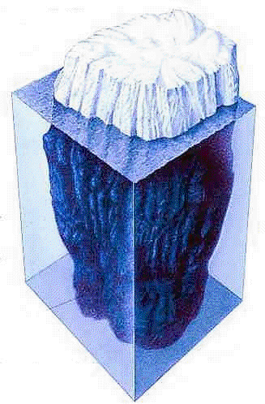
MORE THAN MANNNERISMS Cross Cultural awareness for short-term teams
V. Worldview...
B. World View is...
1. Assumptions about reality
2. Fundamental way of looking at things
3. The grid between the objective world and the way that world is understood by a specific group of people
4. Determines how the events and circumstances of life will be understood, accepted, and acted upon

Slide 26
MORE THAN MANNNERISMS Cross Cultural awareness for short-term teams
VI. Determining Worldview...

Slide 27
MORE THAN MANNNERISMS Cross Cultural awareness for short-term teams
VI. Determining Worldview...
A. Needed for heart level ministry...

Slide 28
MORE THAN MANNNERISMS Cross Cultural awareness for short-term teams
VI. Determining Worldview...
A. Needed for heart level ministry...
What is the character of human nature?
What is the relation of man to nature?
What is the time-sense of human life?
What is the mode of human activity?
What is the mode of human relationships?

Slide 29
MORE THAN MANNNERISMS Cross Cultural awareness for short-term teams
VII. Biblical Examples...

Slide 30
MORE THAN MANNNERISMS Cross Cultural awareness for short-term teams
VII. Biblical Examples...
A. Genesis 15:9
B. Genesis 43:32 & 46:34
C. John 4:9, 6:48, 13:1-15
D. Mark 7:1-4
E. Acts 10:10-16,34
F. Acts 15:21
G. 1 Cor 1:23

Slide 31
MORE THAN MANNNERISMS Cross Cultural awareness for short-term teams
VIII. General Principles for Effective Cross Cultural Ministry
A. Pray for patience.
B. Be an observer and listener.
C. Don’t draw quick conclusions.
D. Don’t compare cultural traits.
E. Different cultures don’t naturally like each other.
F. Hospitality can be a cultural trait. It doesn’t mean they like you!

Slide 32
MORE THAN MANNNERISMS Cross Cultural awareness for short-term teams
IX. Preparation for Trip
A. Try to find someone from that country and ask them the worldview questions.
B. Ask a few non-Americans their observations regarding American cultural traits: mannerisms, language, foods, dress, housing, family relationships, death.

